Slide 1
Credit Risk Assessment Pipeline
Presented by-
Vanamoju Preethi
Aakriti Tripathi
Nandi Gopi Kumar
Renangi Ganesh

Slide 2
Projective Overview and Objective
Technical Specifications
Design solutions with HLD and LLD
Development of Lakehouse in Databricks
Testing the ETL pipelines in AWS and Databricks
Business Outcomes

Slide 3
Project Overview & Objectives
The Credit Risk Assessment Pipeline is built to help financial institutions make accurate, faster, and more transparent lending decisions. To manage large-scale data, the solution leverages auto-scaling Databricks clusters and organized Unity Catalog schemas and Delta tables, making data reliable, auditable, and analytics-ready.
Primary Goals:
Enable efficient risk scoring and decision-making.
Improve data quality and reduce manual errors via automation.
Implement scalable, traceable, and auditable data engineering workflows.

Slide 4
Business / Technical Specifications
Build ETL Pipelines using AWS,DATABRICKS Kaggle Dataset as source for performing below activities:
Implementing Lakehouse's as part of Databricks
Establishing Raw Data store in Databricks Bronze layer Unity Data Catalogs
Perform Data Cleansing, Data Scrubbing activities using Bronze layer Data catalog information
Derive Metrics information with various aggregates using Transformed Silver Layer Data Catalogs Information.

Slide 5
Design Solutions for building pipelines
High level design
Low level design

Slide 6
High Level Design

Slide 7
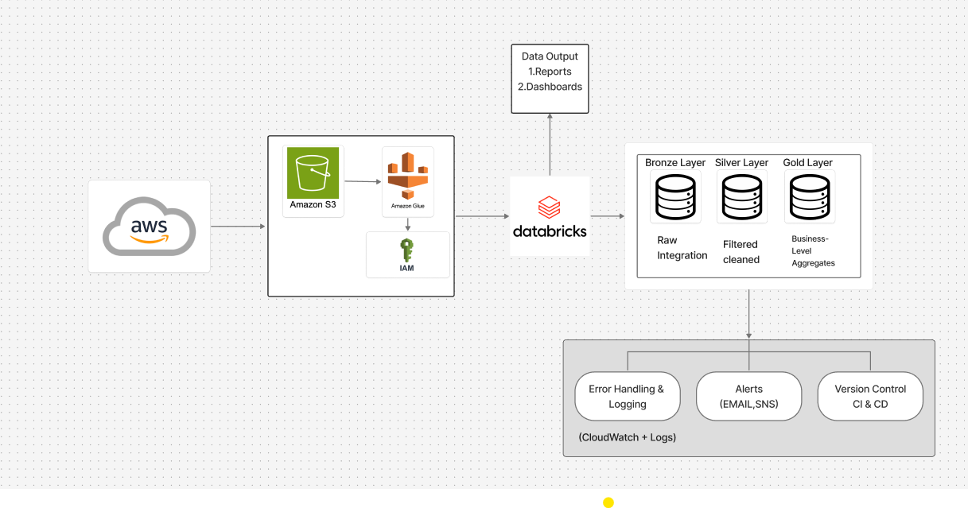

Slide 8
Low Level Design

Slide 9
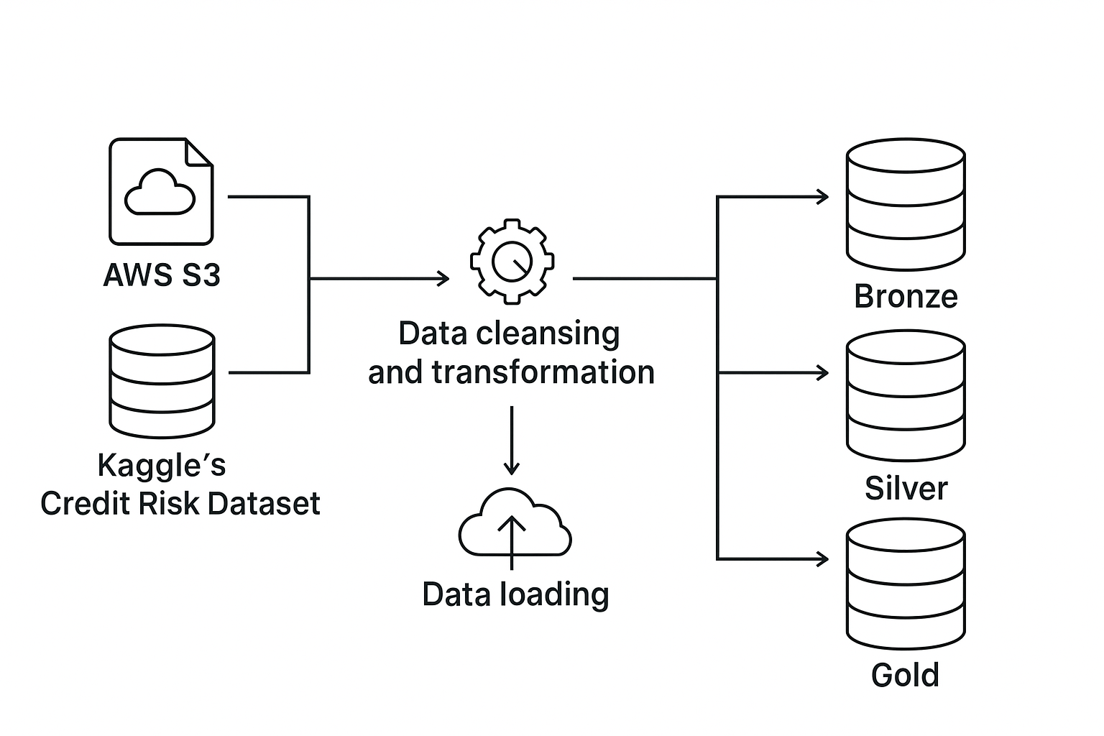
Building ETL Pipelines in AWS and Databricks

Slide 10
Building ETL Pipelines in AWS and Databricks
Pipeline Orchestration in AWS AND DATABRICKS
Error Handling mechanisms in AWS AND DATABRICKS
Data Quality checks using DLT expectations and other approaches
Building ALERTS , Audit and error logs in Databricks
Data Visualisation for better analysis
Git Integration

Slide 11
Error Handling & Data Quality Checks
Schema Validation – Enforce expected schema (column names, data types, mandatory fields) to detect malformed records.
Deduplication & Integrity Checks – Remove duplicate applications, validate primary keys (e.g., applicant_id, loan_id).
Null & Outlier Handling – Apply default values, imputation, or rejection rules for missing/invalid fields (e.g., negative loan amounts).
Error Logging – Capture failed records in a dedicated error table/logs (e.g., credit_catalog.logs.etl_errors) with timestamp & error reason.

Slide 12
Pipeline orchestration
Workflow Orchestration – Use AWS Glue Workflows (AWS setup) or Databricks Workflows (Databricks setup) to chain ETL jobs in sequence (Bronze → Silver → Gold).
Job Scheduling – Configure daily batch runs at 5 AM UTC using Event Bridge (AWS) or built-in scheduler (Databricks).
Dependency Management – Ensure downstream jobs (Silver/Gold) run only after upstream tasks (Bronze/Silver) succeed.
Monitoring & Logging – Track job execution with CloudWatch (AWS) or Databricks Job Runs UI, storing logs for audits.
Failure Handling & Alerts – On job failure, send alerts via SNS/email and rerun failed tasks without reprocessing entire pipeline.

Slide 13
Alerts / Monitoring / logging
Job Monitoring – Track ETL job runs in Databricks Jobs UI or AWS Glue/CloudWatch (status: success, failed, duration, DPU usage).
Data Quality Alerts – Trigger alerts if schema mismatches, duplicate counts, or null ratios exceed thresholds.
Error Logging – Log failed records and exceptions into a dedicated table (e.g., credit_catalog.logs.etl_errors) for root-cause analysis.
Notifications – Integrate with Amazon SNS (AWS) or Databricks email/webhook alerts to notify stakeholders instantly on failures or anomalies.
Performance & Cost Monitoring – Use CloudWatch metrics / Databricks Ganglia metrics to track job runtime, storage growth, and optimize cluster/DPU costs.

Slide 14
Development of Lakehouse
BUILD ETL PIPELINES IN AWS AND DATA BRICKS AS PER REQUIREMENT:
Data ingestion into aws delate lake
Building catalogues and feeding unity catalogue tables in bronze layer from aws s3 ingested data file
Building catalogues and feeding unity catalogue tables in Silver layer
Building catalogues and feeding unity catalogue tables in Gold layer

Slide 15
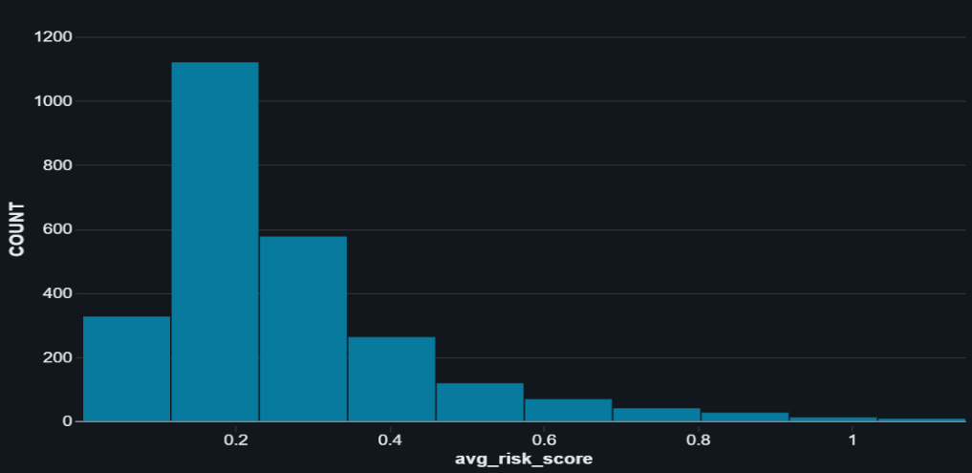
Visualization
This is a histogram, a type of bar chart used to show the distribution of a continuous variable.
The x-axis represents the avg_risk_score values, which are grouped into bins (e.g., 0.0-0.1, 0.1-0.2, etc.). The y-axis represents the frequency or count—the number of cases that fall within each score range.

Slide 16
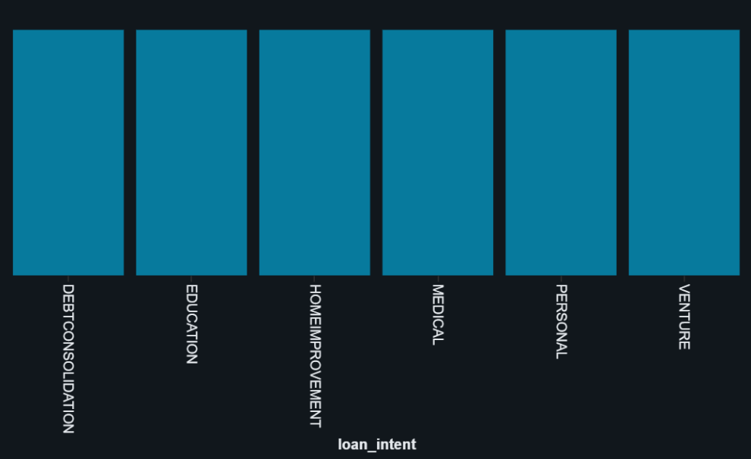
Visualization
This graph is a Bar Graph showing the distribution of Loan_intent.
X-axis (loan_intent): Represents the purpose of loan applications such as:Debt ConsolidationEducationHome ImprovementMedicalPersonalVentureY-axis: Represents the number of loan applications (though the exact scale isn’t visible in the image).

Slide 17
Testing ETL Pipelines
Data Validation: Testing Use Pytest to write unit tests that check for missing values, invalid formats, or incorrect data types in incoming loan applications. Example: Ensure loan_amount is always positive, credit_score falls within a valid range.
Business Rule Validation : Test risk rules such as: If credit score < 600 → mark as high risk. Unit tests confirm the logic is applied consistently across datasets.
Pipeline Component Testing: Each stage (data ingestion → transformation → model scoring → output) is tested separately with Pytest.

Slide 18




Business Impact & Outcomes
Accurate, Transparent Risk Assessments
Comprehensive data pipeline ensures reliable credit evaluation with full audit trail
Faster, Automated Loan Approvals
Streamlined process replaces manual reviews, reducing decision time
Fewer Defaults, Better Risk Control
Data-driven decisions minimize financial exposure and improve portfolio quality
Scalable Solution for Growing Volume
Architecture designed to handle increasing application loads without performance degradation

Slide 19
Thank you
We appreciate your time and attention.
Made with Genspark

